Slide 1
MGB1201 Python Programming Project Phase - 2
Project Member 1:DHIYANESHWARAN.V
Project Member 2:RAHUL.D

Slide 2
INTRODUCTION
CAD is mainly used for detailed design of 3D models or 2D drawings of physical components, but it is also used throughout the engineering process from conceptual design and layout of products, through strength and dynamic analysis of assemblies to definition of manufacturing methods of components.

Slide 3
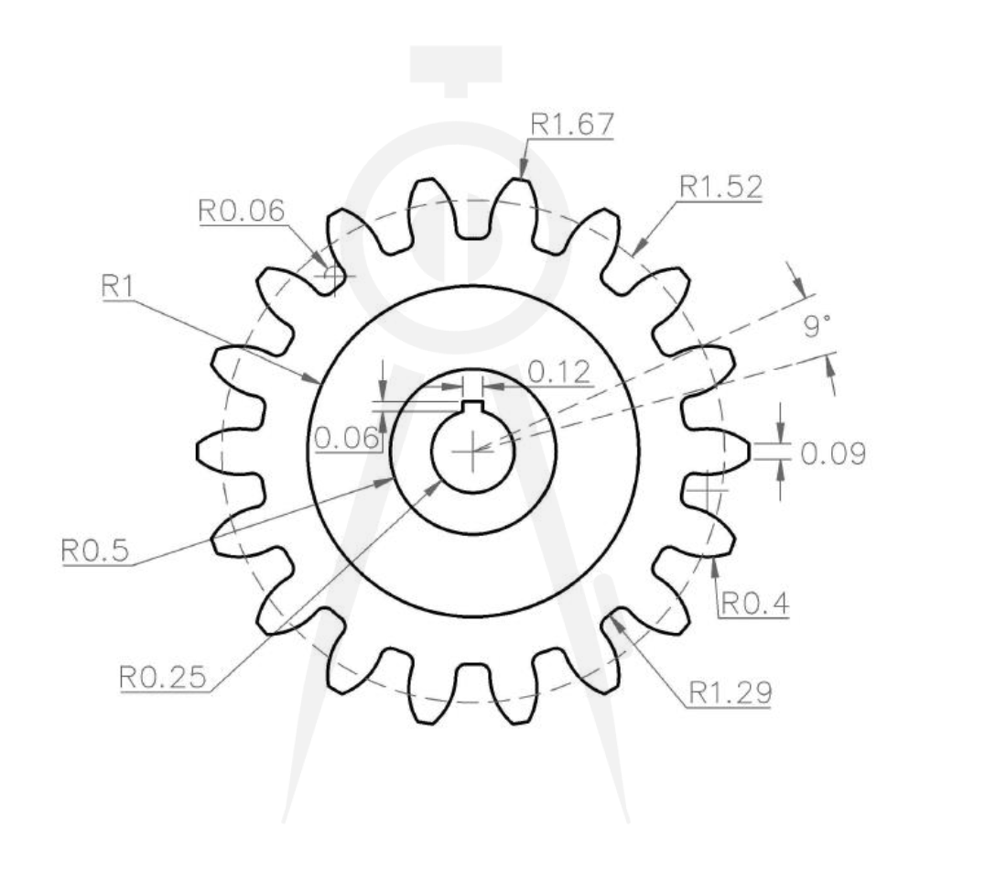
Title: Drawing and CAD: Create 2D and 3D drawings of mechanical components using Python libraries (e.g., Shapely, Plotly).
Image:

Slide 4
Key words:
Problem statement
•2D Drawings •3D Drawings •Mechanical components •Shapely (Library) •Plotly (Library)
Project goals
•Geometric Features
•Python Libraries
•Visualization
•Modular System

Slide 5
Empathy and Design Challenge
Title: Gear
Image:

Slide 6
Key points:
• Understanding user Needs:
Detailed Geometry: Provides realistic representation of gears, including helical teeth, hubs, and keyways.

Slide 7
Ideation and Prototyping
Title: Brainstorming Solutions
Key points:
AI-Assisted Component Design
Smart Component Library
Real-Time 2D-to-3D Transitionsn every steps)

Slide 8
Testing and Iteration
Title: User Testing and Feedback
Testing Method: Use known geometric and mechanical standards (e.g., ISO gear profiles) and compare the generated output with existing CAD models.
Feedback Collection: Engineers or CAD designers review the drawings and confirm whether the dimensions and shapes are as expected.

Slide 9
Key points:
2D CAD is two-dimensional, while 3D CAD is three-dimensional.

Slide 10
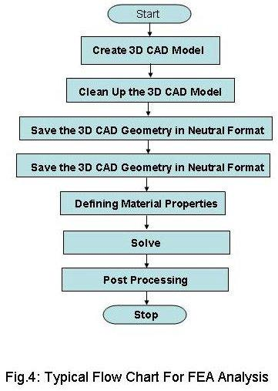
Work Methodology Flowchart

Slide 11
Python Programming Work Methodology Flowchart Template
Start
Understand the Problem: Issue: Designers often spend excessive time on repetitive tasks such as drawing, modifying, and updating components.
Plan Your Approach: Develop essential functionalities such as 2D and 3D modeling, parametric design, and geometric constract

Slide 12
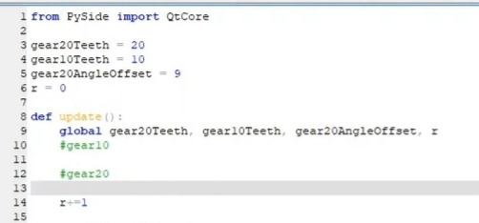
Design code :

Slide 13
Literature Review & Problem Identification
Key Points:
CAD has transformed design practices across various fields, enabling efficient creation and manipulation of 2D and 3D models.

Slide 14
Gantt Chart Template
Task | 23.09.24 | 24.09.24 | 24 hours | COMPLETED
Task 1 | 23.09.24 | 24.09.24 | 24 hours | COMPLETED
Task 2 | 23.09.24 | 24.09.24 | 24 hours | COMPLETED
Task 3 | 26.09.24 | 26.09.24 | 24 hours | COMPLETED
Task: A task is a specific activity or job that needs to be completed.
Status: [Legend for different status indicators, e.g., Completed, In Progress, Not Started]

Slide 15
Conclusion and Future Directions
The literature review highlights critical areas of research, such as user interface design, parametric modeling, and integration with other systems, which underscore the importance of user-centric design approaches and seamless interoperability.

Slide 16
Reference format
K. M. S. L. B. Silva, R. T. da Cruz, and P. M. S. A. L. Silva. (2021). "User-Centered Design in CAD: A Study of User Interface and Usability." Journal of Engineering Design, 32(5), 243-261.

Slide 17
